Slide 1
Introduction to Computing for Data Analysis
Logistic regression (classification)
Richard Vuduc, Ph.D.
Associate Professor
School of Computational Science and Engineering
Classification tasks
Notes:
Hi, it’s great to see you again.
In this lesson, I want us to think about another important analysis task, which is “classification.”
In it, you are given a bunch of labeled data, and you want to learn a model of the labels.

Slide 2
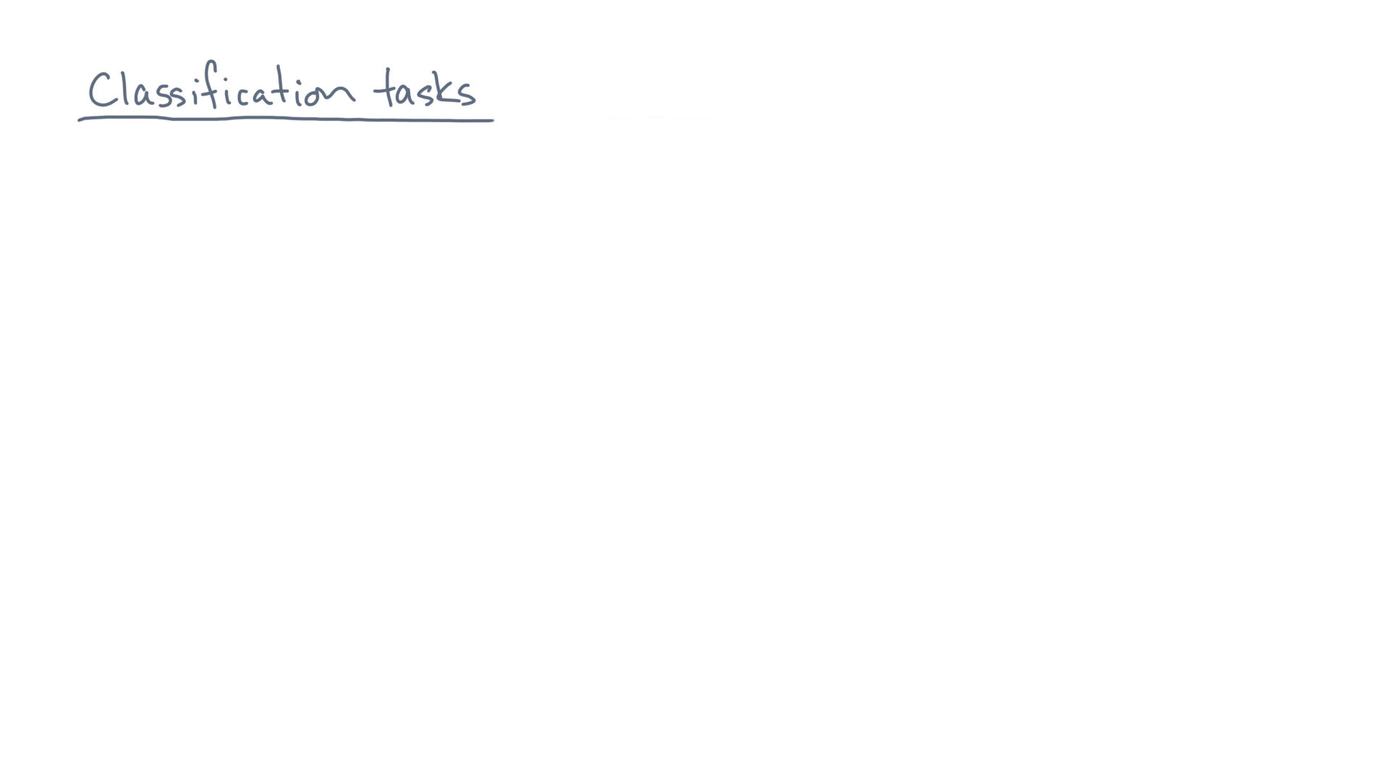
Notes:
Let’s start with a quick example.
It comes from the following study by some marine biologists.

Slide 3
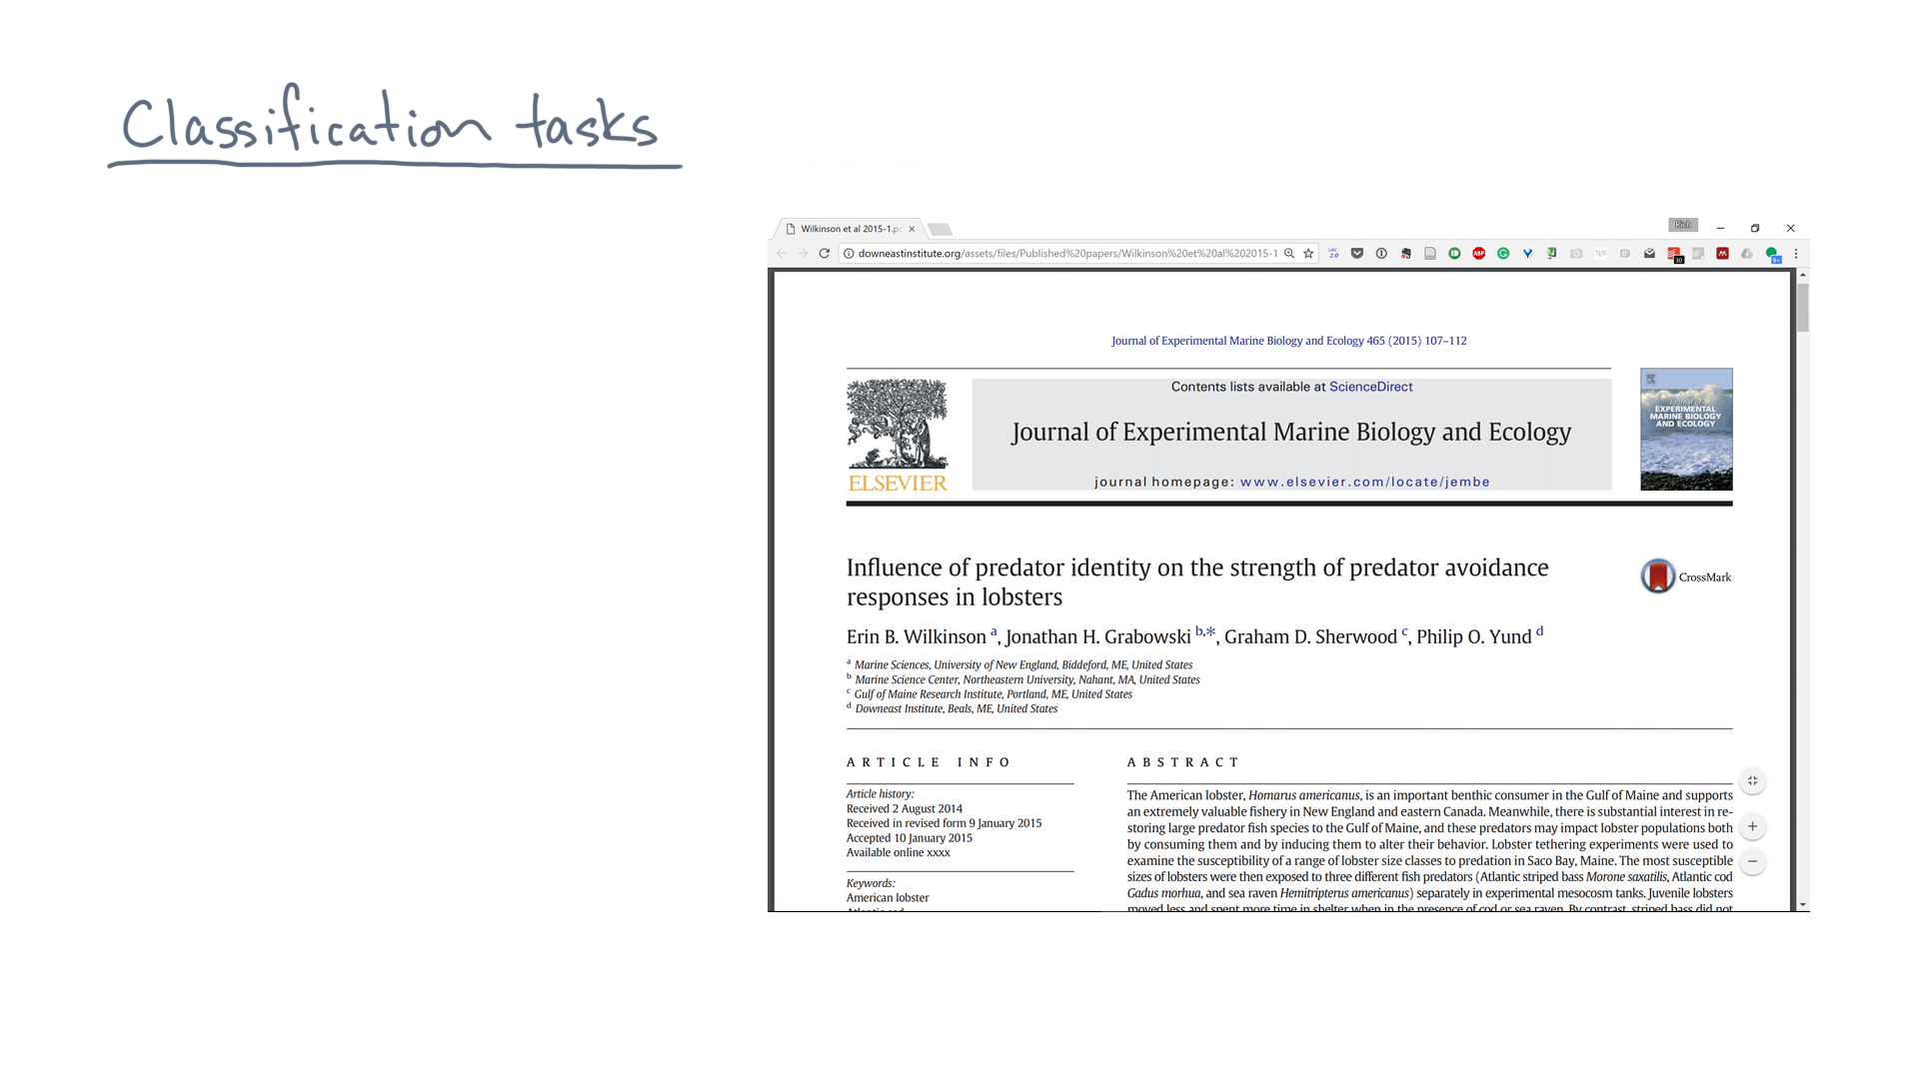
Notes:
They were studying lobsters.

Slide 4

Notes:
For each one, they measured its length.

Slide 5
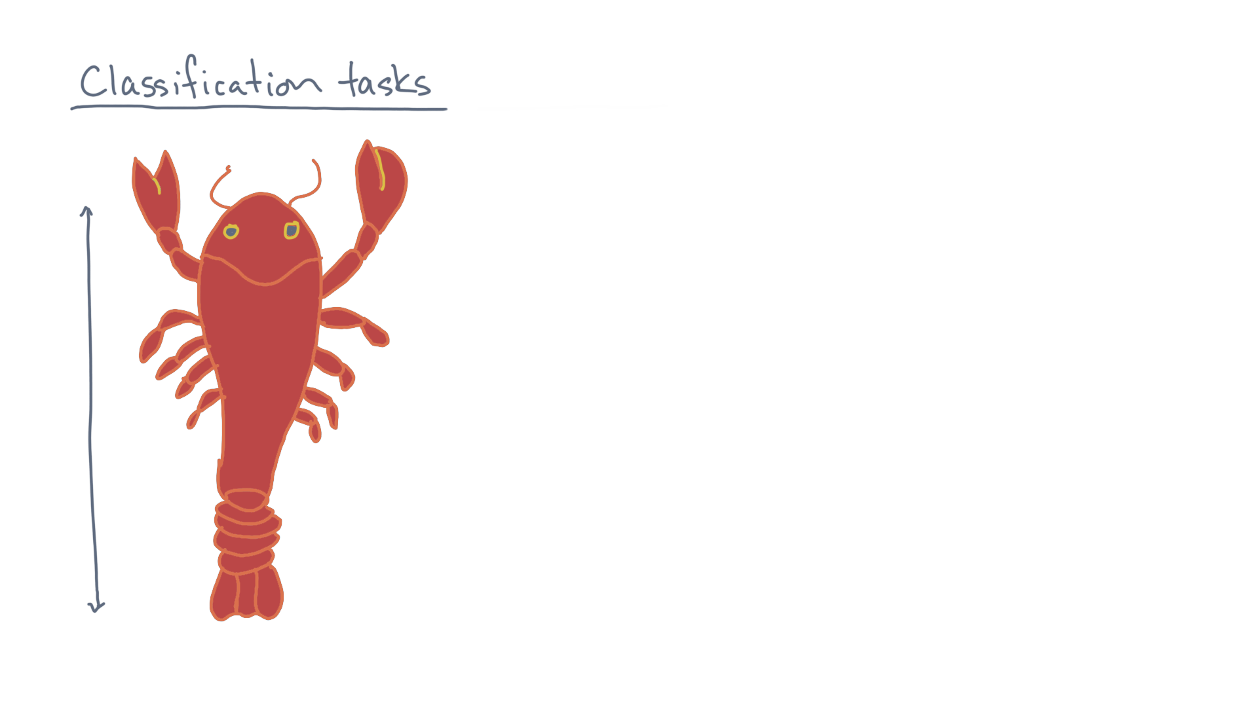
Notes:
They then subjected the lobsters to a variety of predators.

Slide 6
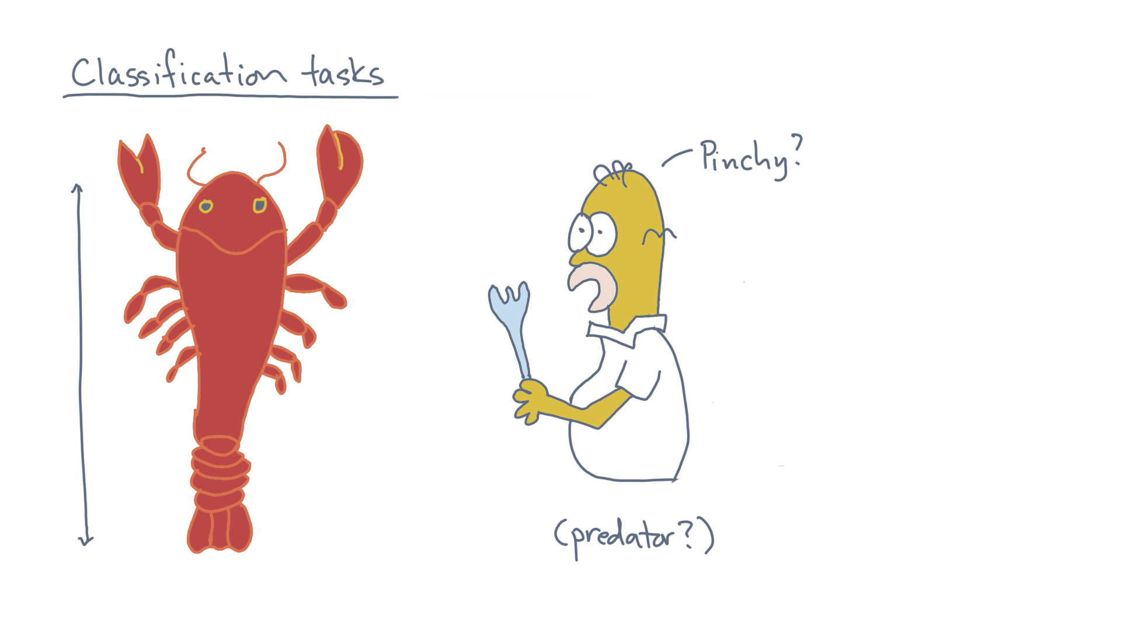

Notes:
They wanted to compare the lobster’s size with whether the lobster could survive.

Slide 7
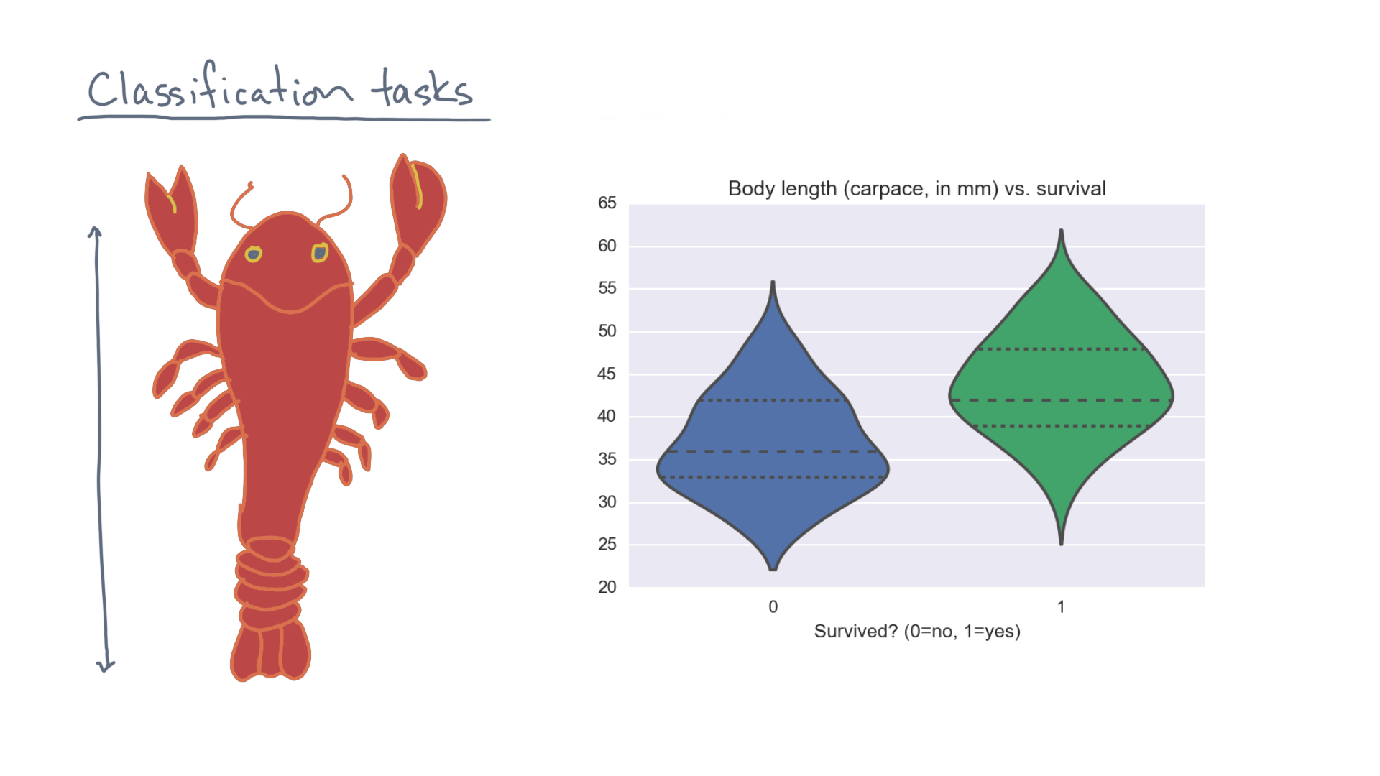
Notes:
The data they collected looked something like this.

Slide 8
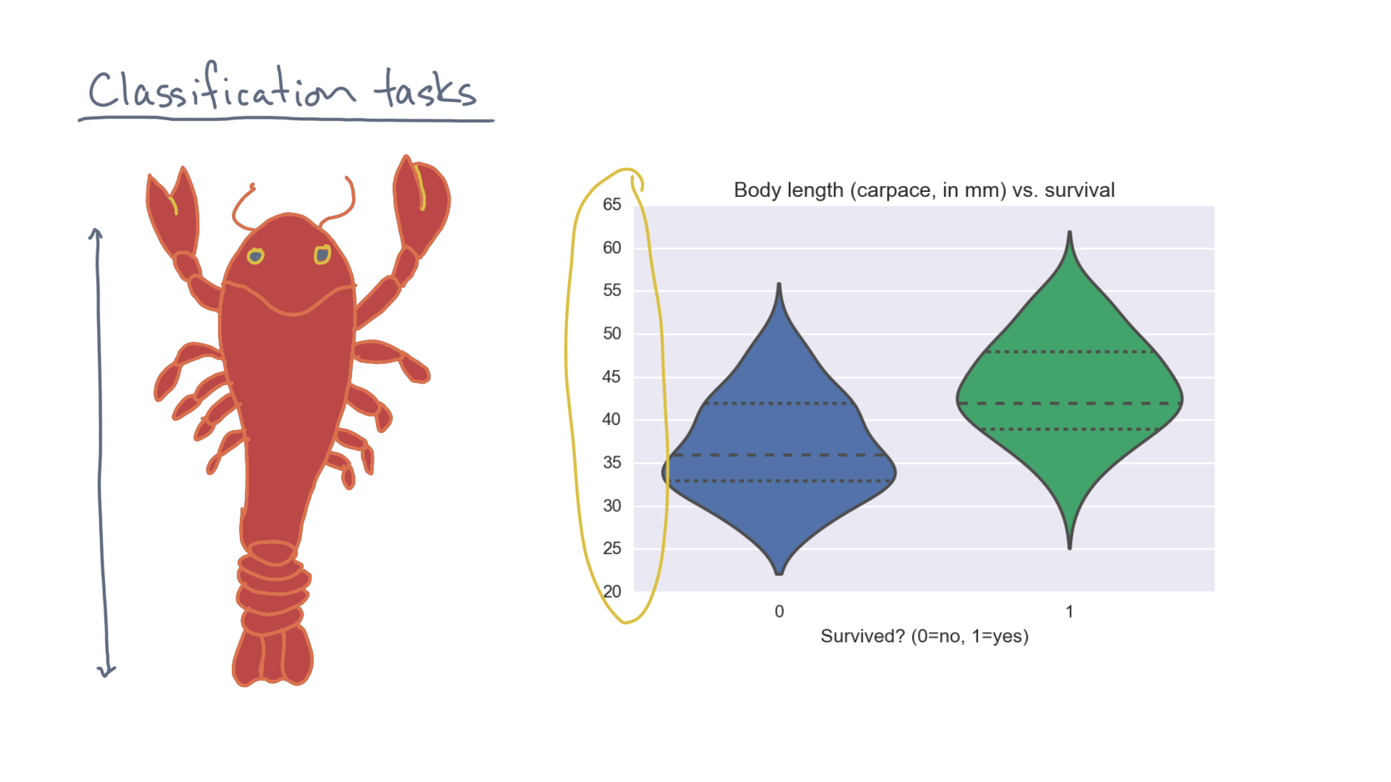
Notes:
As a function of body length, along the y-axis, …

Slide 9
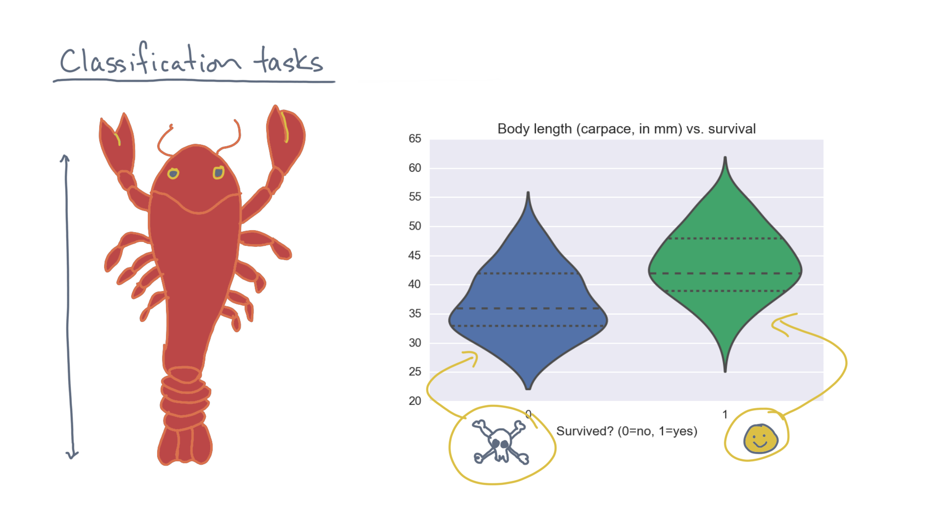
Notes:
… this plot shows whether lobsters made it or not.

Slide 10
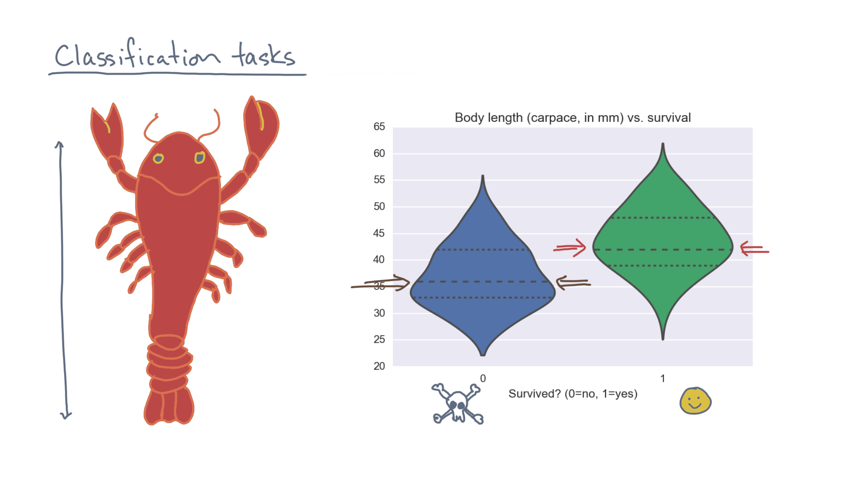
Notes:
These distributions, plotted as violins, appear to be distinct.

Slide 11

Notes:
Though you can also see it’s a hard problem since they are not cleanly separable.

Slide 12

Notes:
In any case, our analysis goal is to try to learn a model of these distributions, so we can do things like predict how likely a lobster is to survive a predator.

Slide 13
Notes:
So let’s formalize the task.
Consider this synthetic example data set.

Slide 14
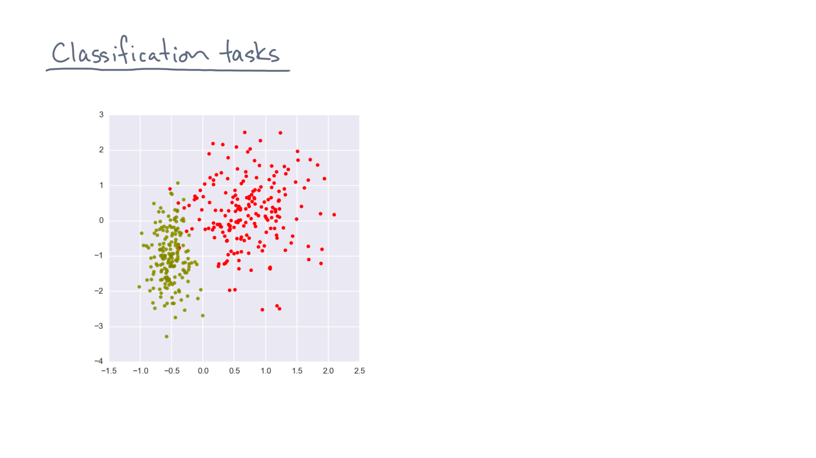
Notes:
It consists of a bunch of points in a continuous two-dimensional space.

Slide 15
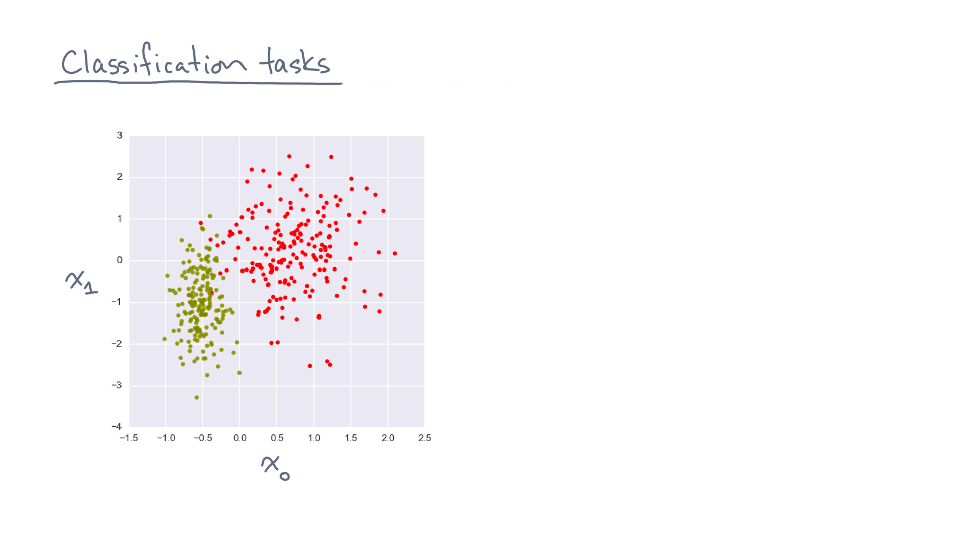
Notes:
Since we’ll be interested in higher-dimensional data in general, let’s label these coordinates “x-zero” and “x-one”.

Slide 16
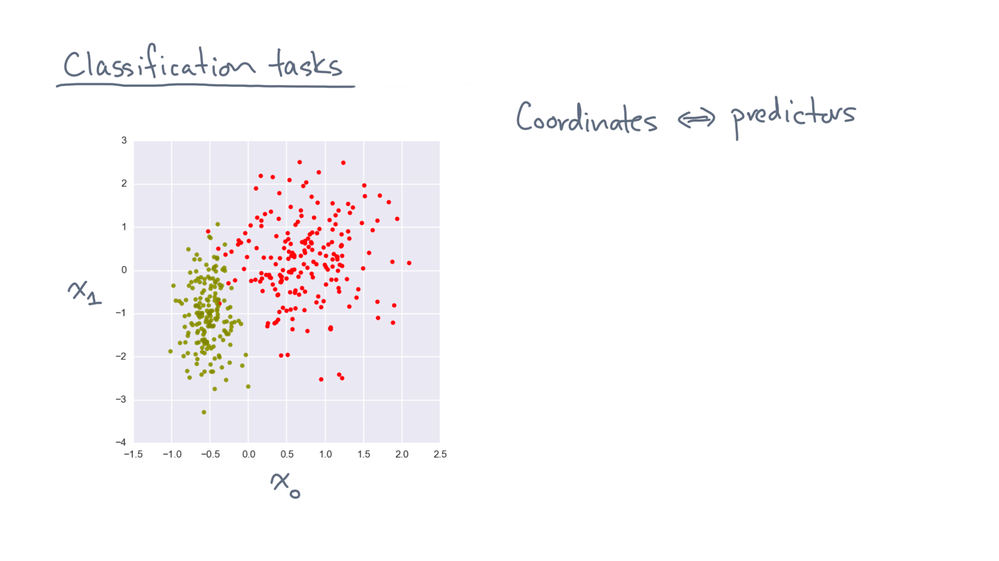
Notes:
Think of these coordinates as continuous-valued predictors, as you might in a regression problem.

Slide 17
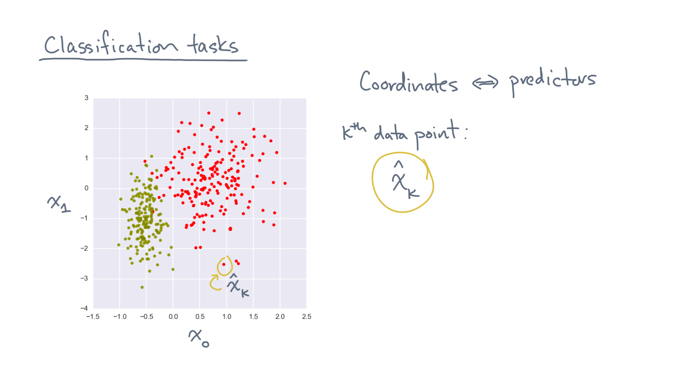
Notes:
Now consider the coordinates of the k-th data point, x-hat-sub-k.

Slide 18
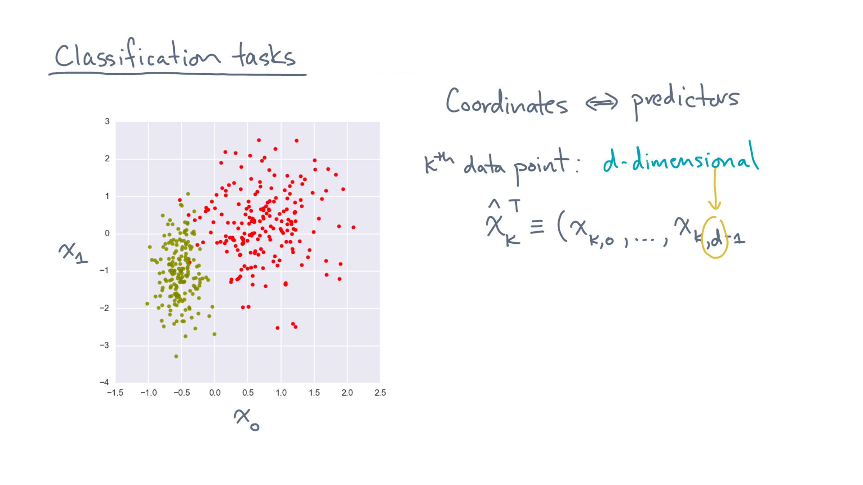
Notes:
It will be d-dimensional in general.
In this example, d equals 2.

Slide 19
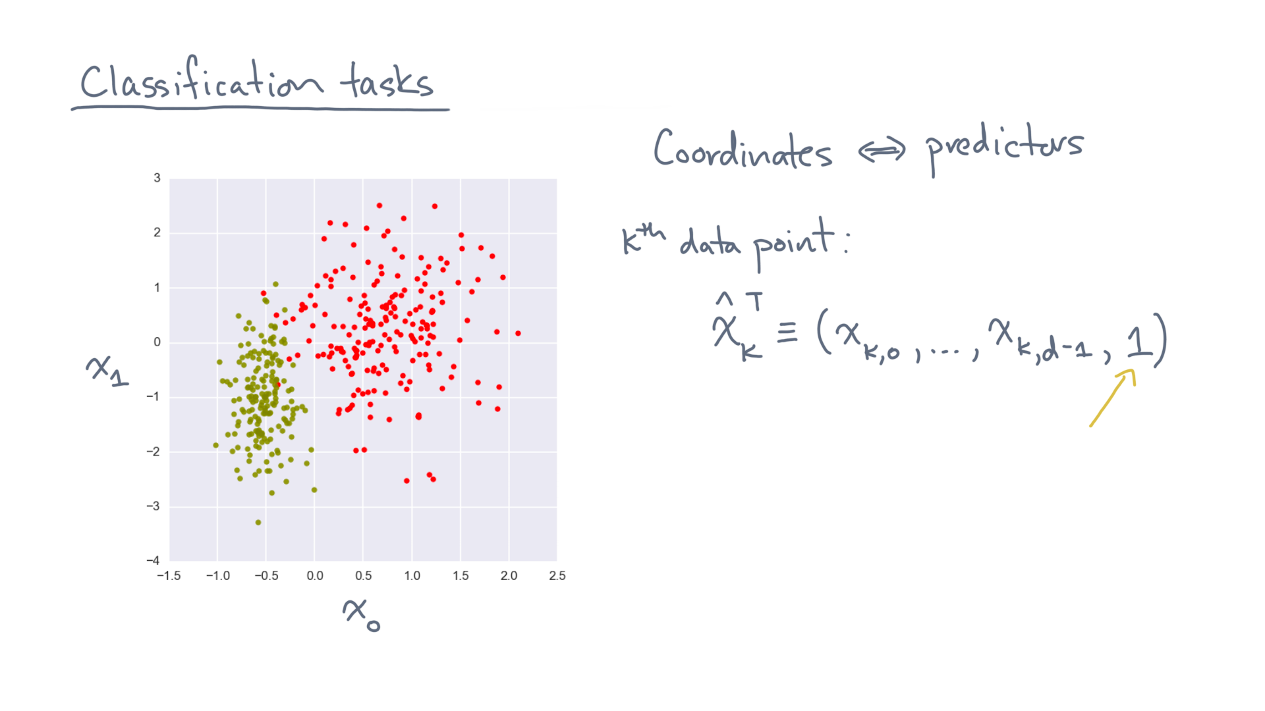
Notes:
Let’s also adopt the convention of adding a dummy coordinate whose value equals 1.
This should be familiar from linear regression, and will make more sense in a moment.

Slide 20
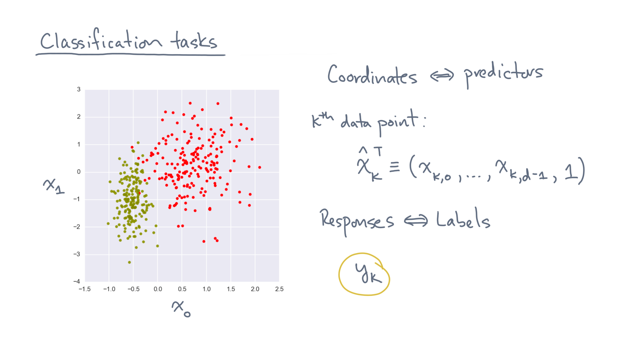
Notes:
Each data point also has a response variable, which is a class label, y-k.

Slide 21
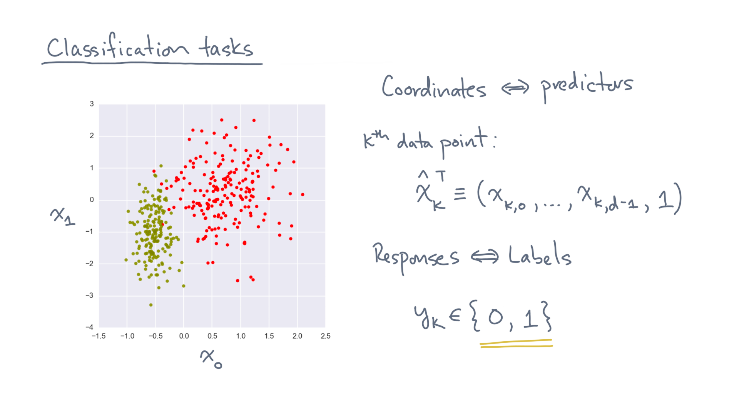
Notes:
For now, let’s consider two classes, which we can represent with binary, or zero-one, labels.
These values could be “died” or “survived” in the lobster example.

Slide 22
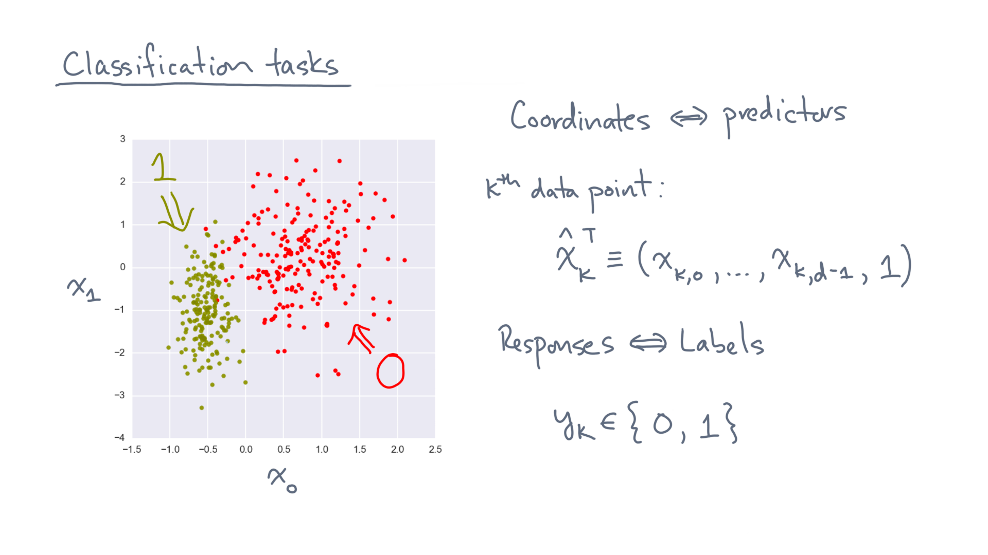
Notes:
The labels are show as the two colors in this example.

Slide 23
Notes:
This picture suggests a *geometric* way to think about the classification problem.

Slide 24
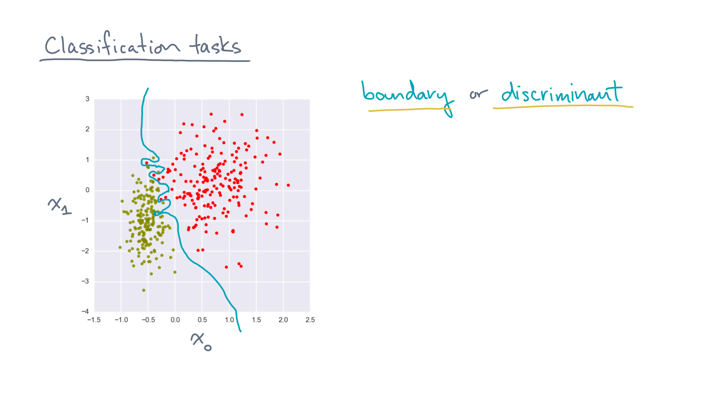
Notes:
We’d like to find a boundary, or “discriminant,” between the two classes.

Slide 25
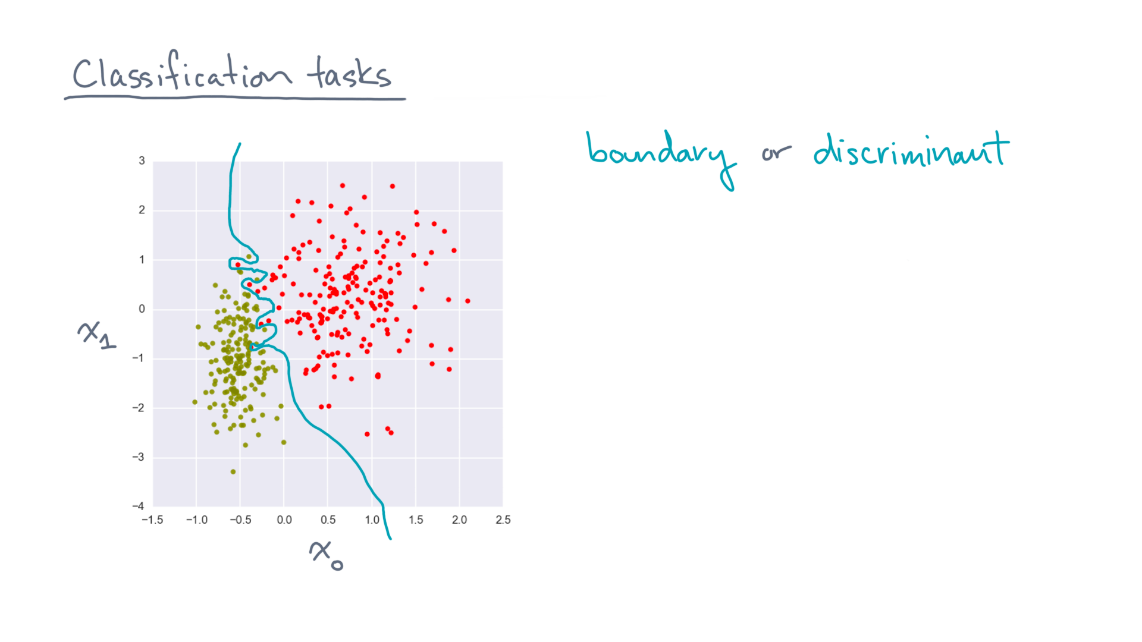
Notes:
Of course, such a boundary might not really exist if the data are not cleanly separable.
The data modeling problem is to find a reasonably good, albeit approximate, boundary.

Slide 26
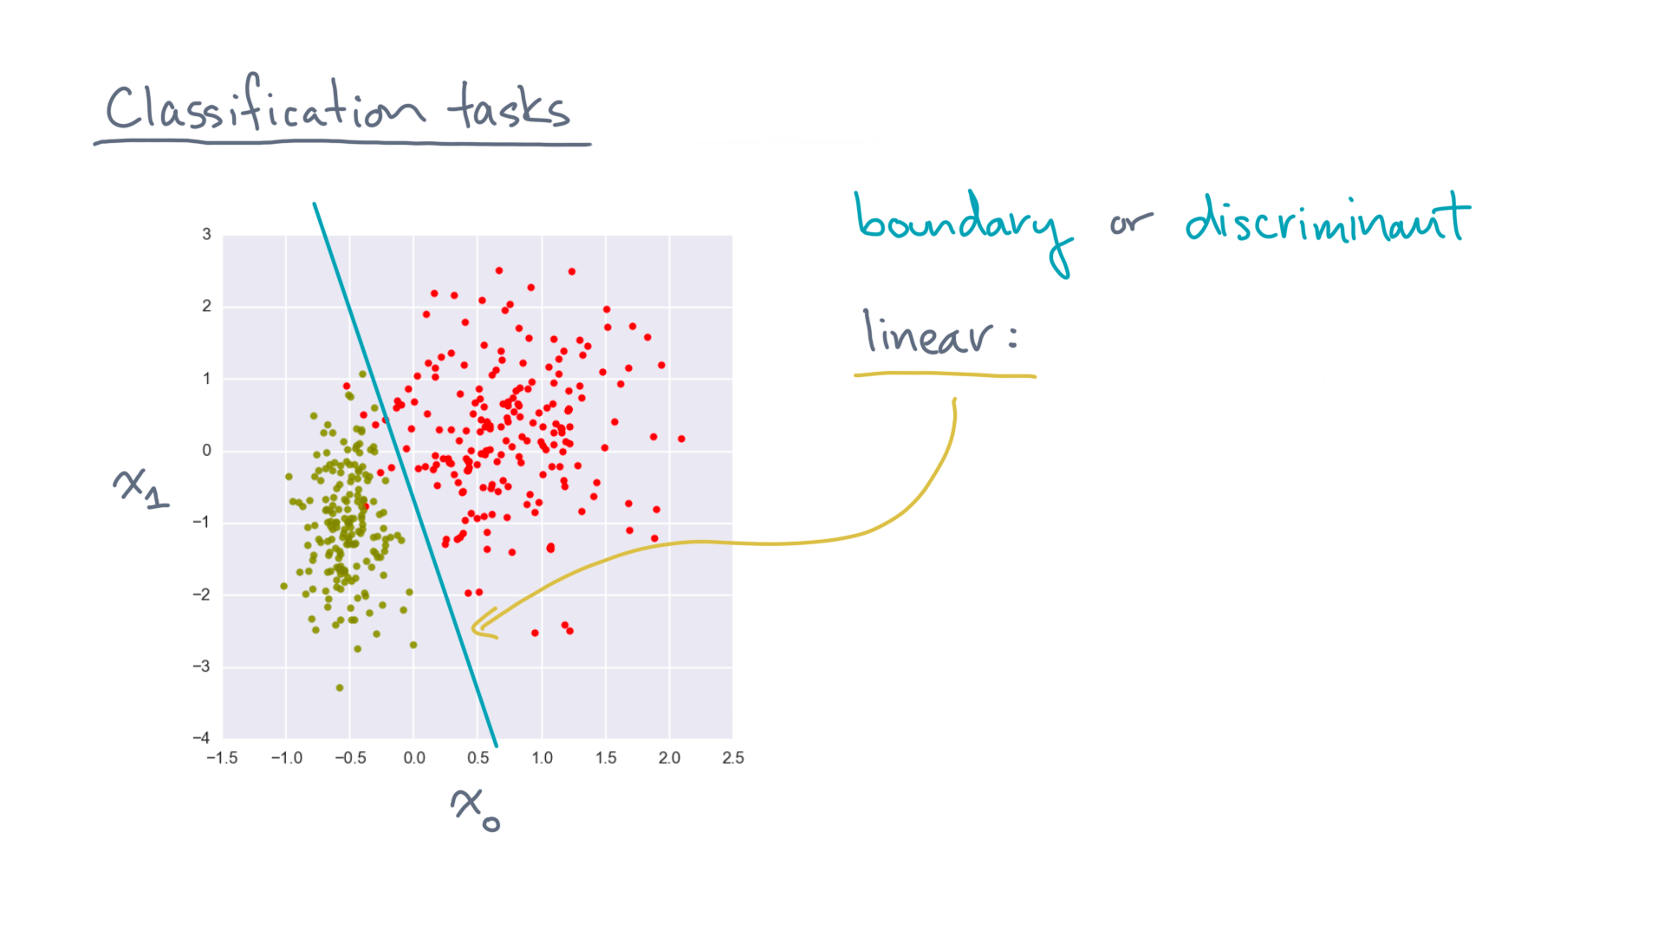
Notes:
The simplest model might be a linear model.
That’s a line in 2-D, or a hyperplane in d-dimensions.

Slide 27
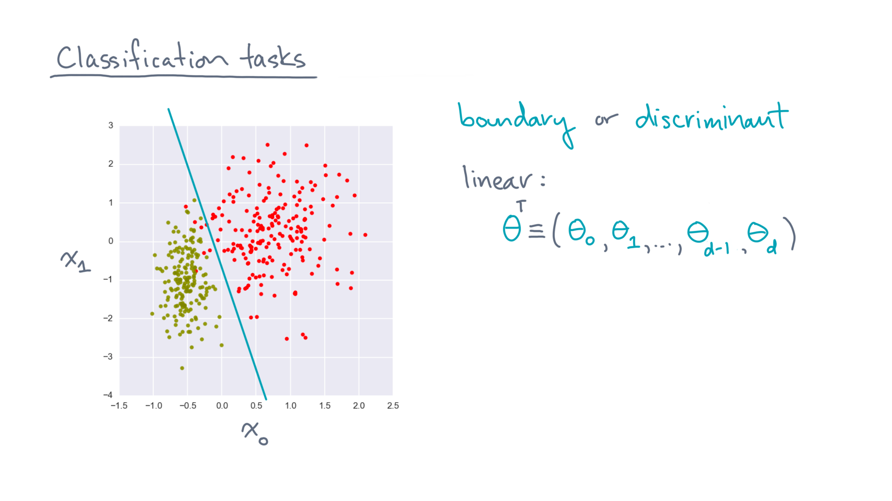
Notes:
Mathematically, we can use a vector of d+1 parameters to represent a d-dimensional hyperplane.

Slide 28
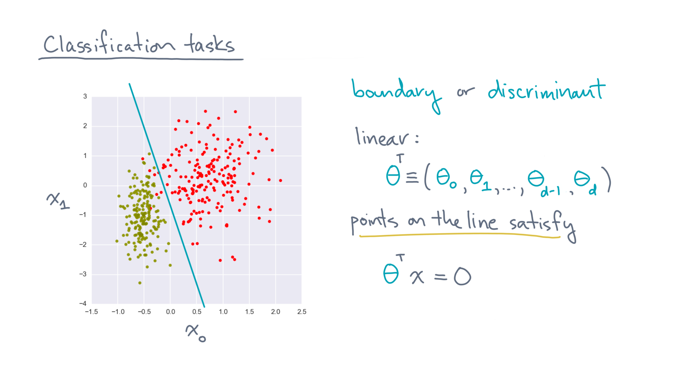
Notes:
Points on the line satisfy

Slide 29
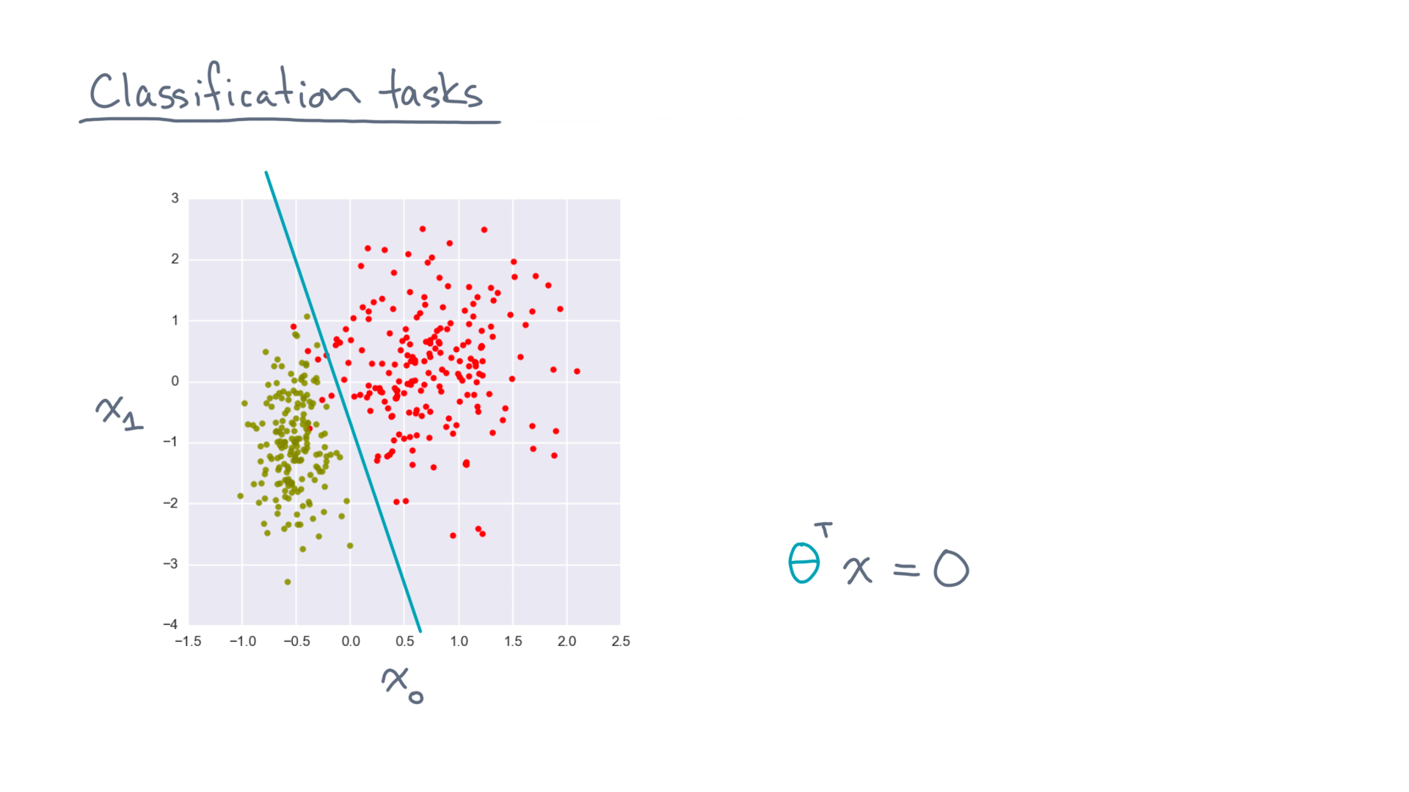
Notes:
For instance, let’s return to this example with d equals 2 predictors.
Theta-transpose-x equals zero is equivalent to the following:

Slide 30
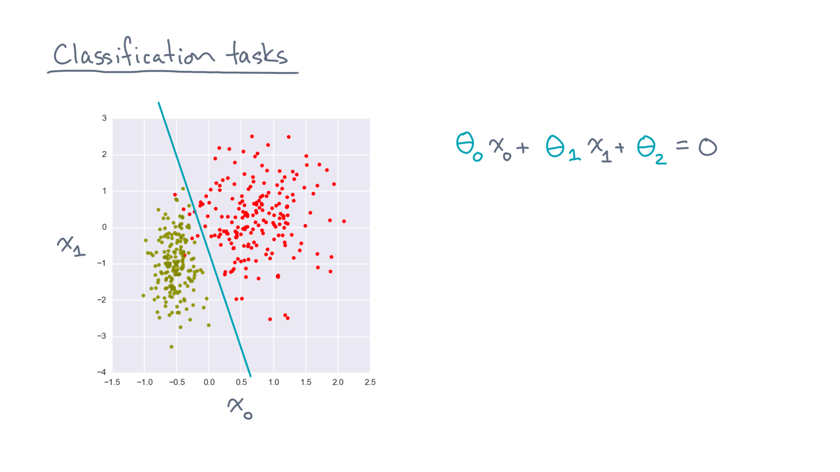
Notes:
theta-0 x-0 plus theta-1 x-1 plus theta-2 (because of the dummy 1 coordinate) equals 0.
This is just the formula for a hyperplane.

Slide 31
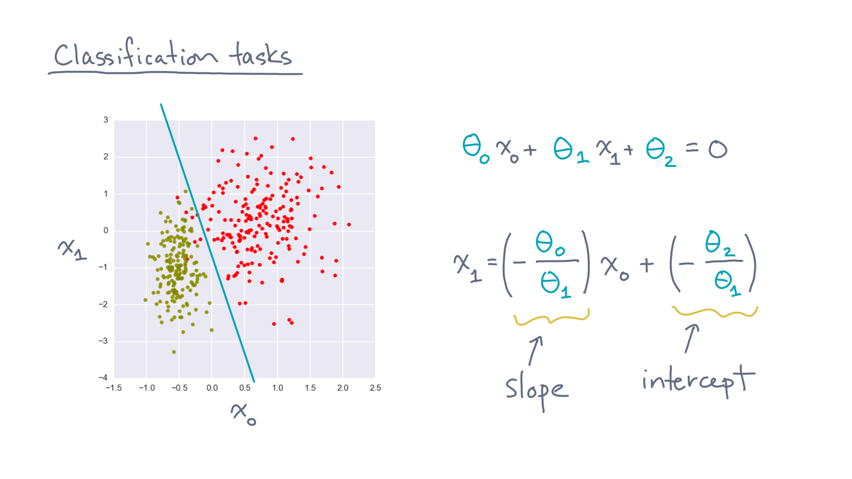
Notes:
You can also rewrite it in an equivalent slope-intercept form.
A line by any other name…

Slide 32
Notes:
Now that describes points *on* the line.
What about other points in the space?

Slide 33
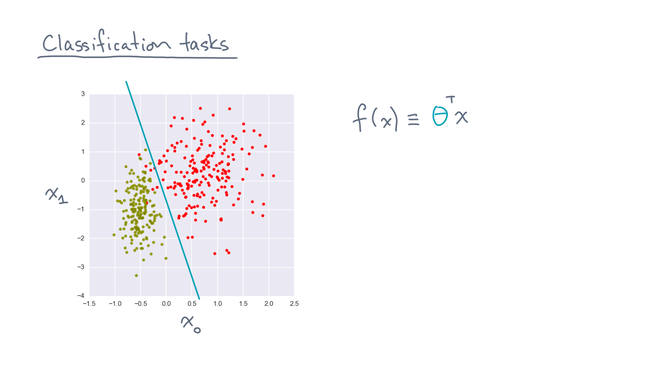
Notes:
Consider the function, f(x), defined to be theta-transpose times x.

Slide 34
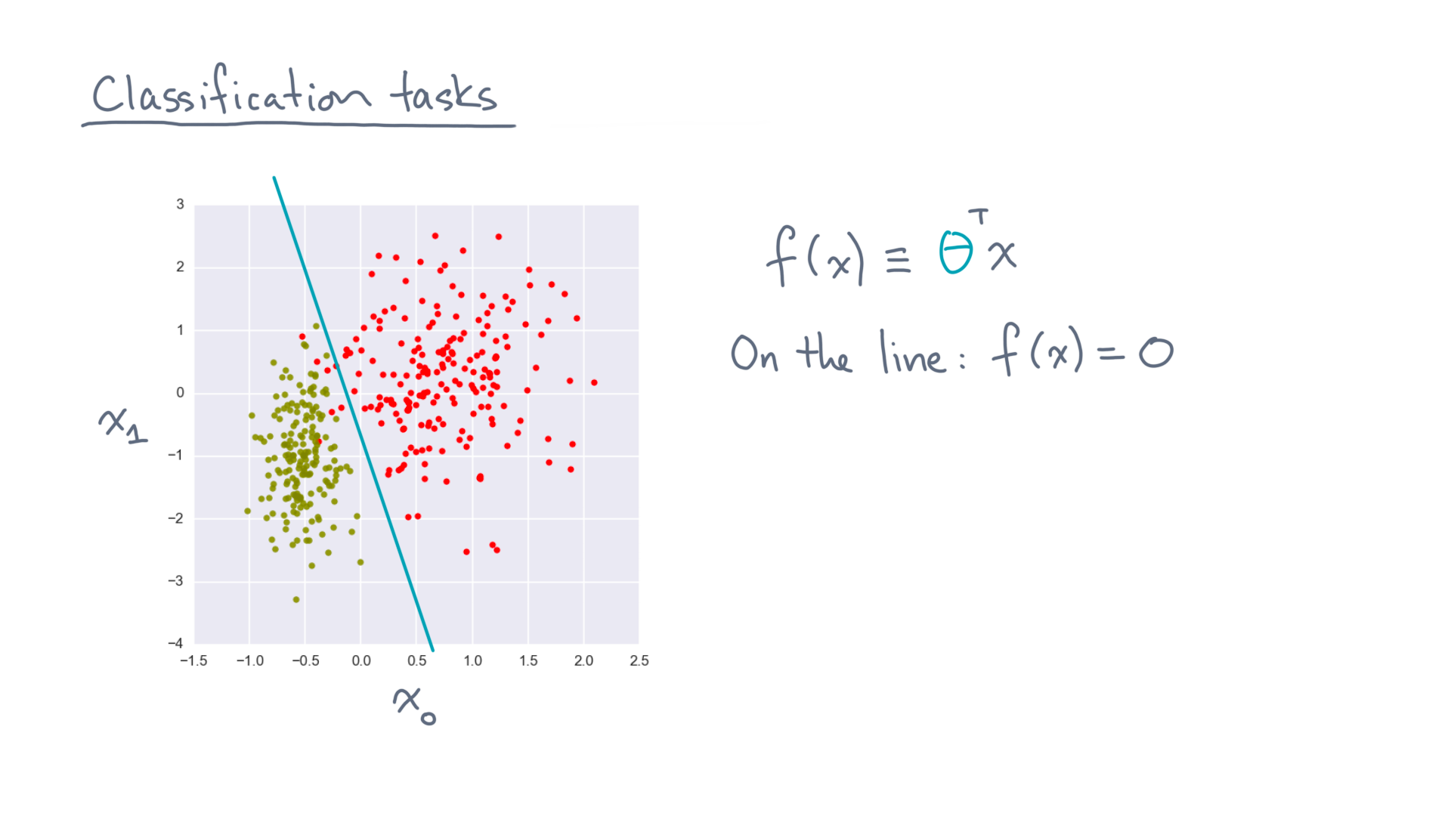
Notes:
We just said this function is zero on the line.

Slide 35
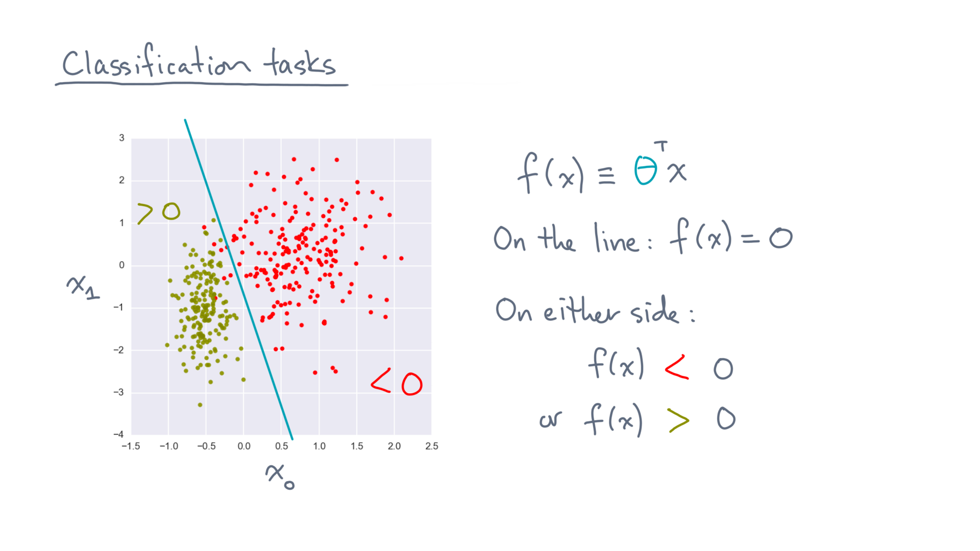
Notes:
For all other points, f(x) will be negative on one side of the line, and positive on the other side.
t

Slide 36
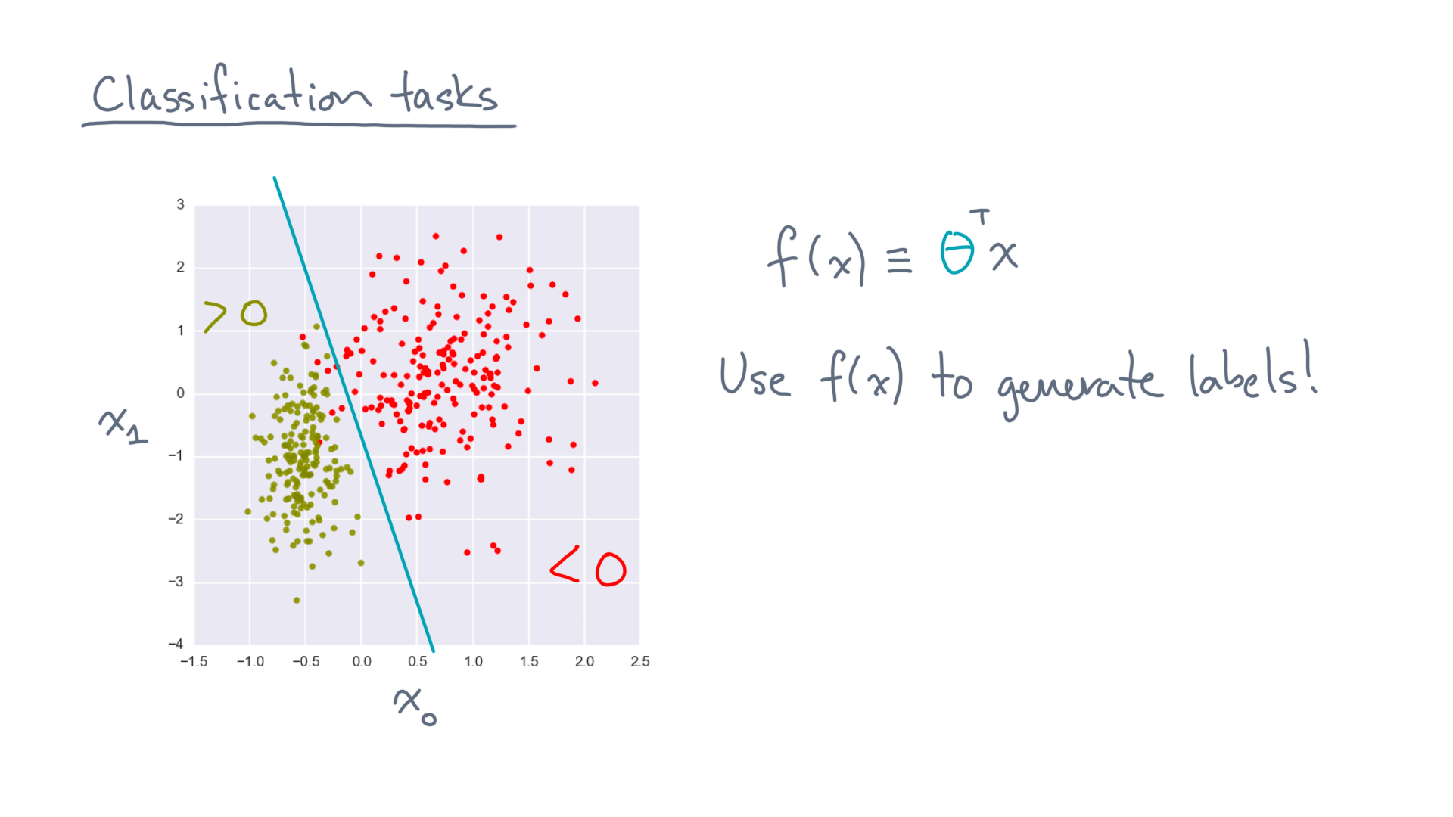
Notes:
That means you can use f(x) to generate labels!

Slide 37
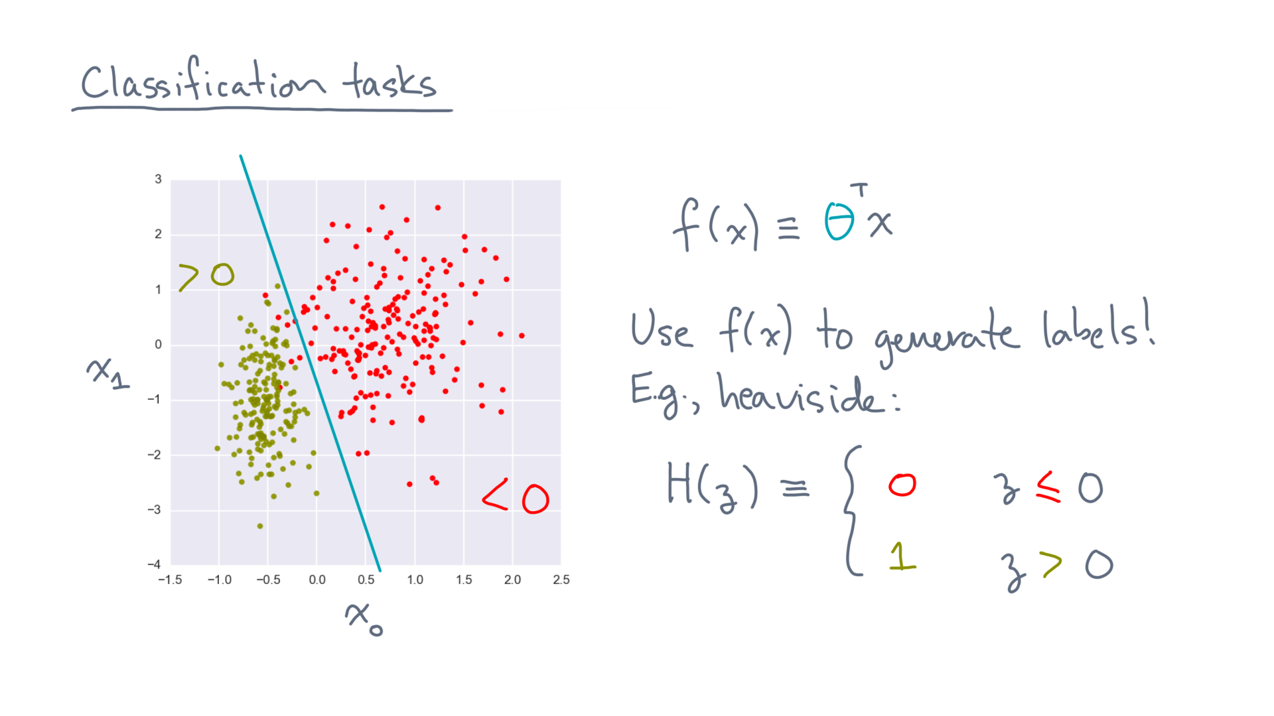
Notes:
For instance, we can use the *Heaviside* function.
It maps negative values to 0 and positive values to 1.

Slide 38
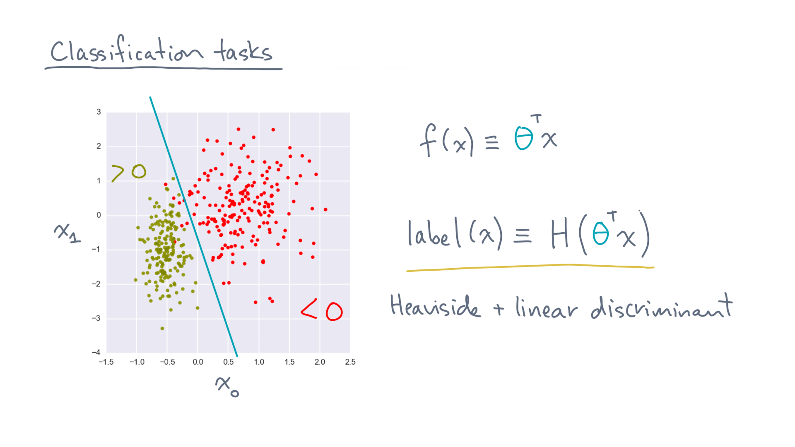
Notes:
That is, you can generate a label for any point x, in the case of a linear discriminant boundary, by applying the Heaviside function to theta-transpose-x.

Slide 39
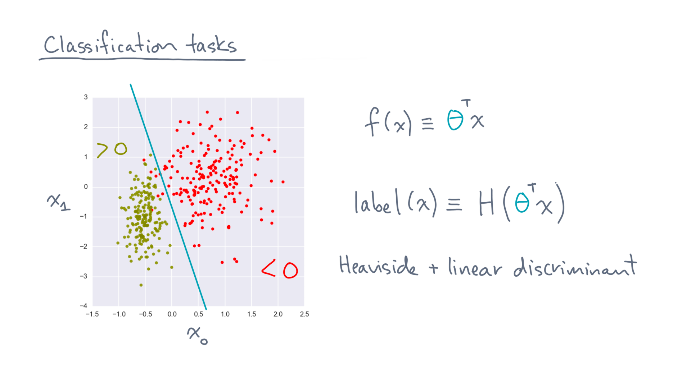
Notes:
Now that’s all well and good, but we still have a problem.

Slide 40
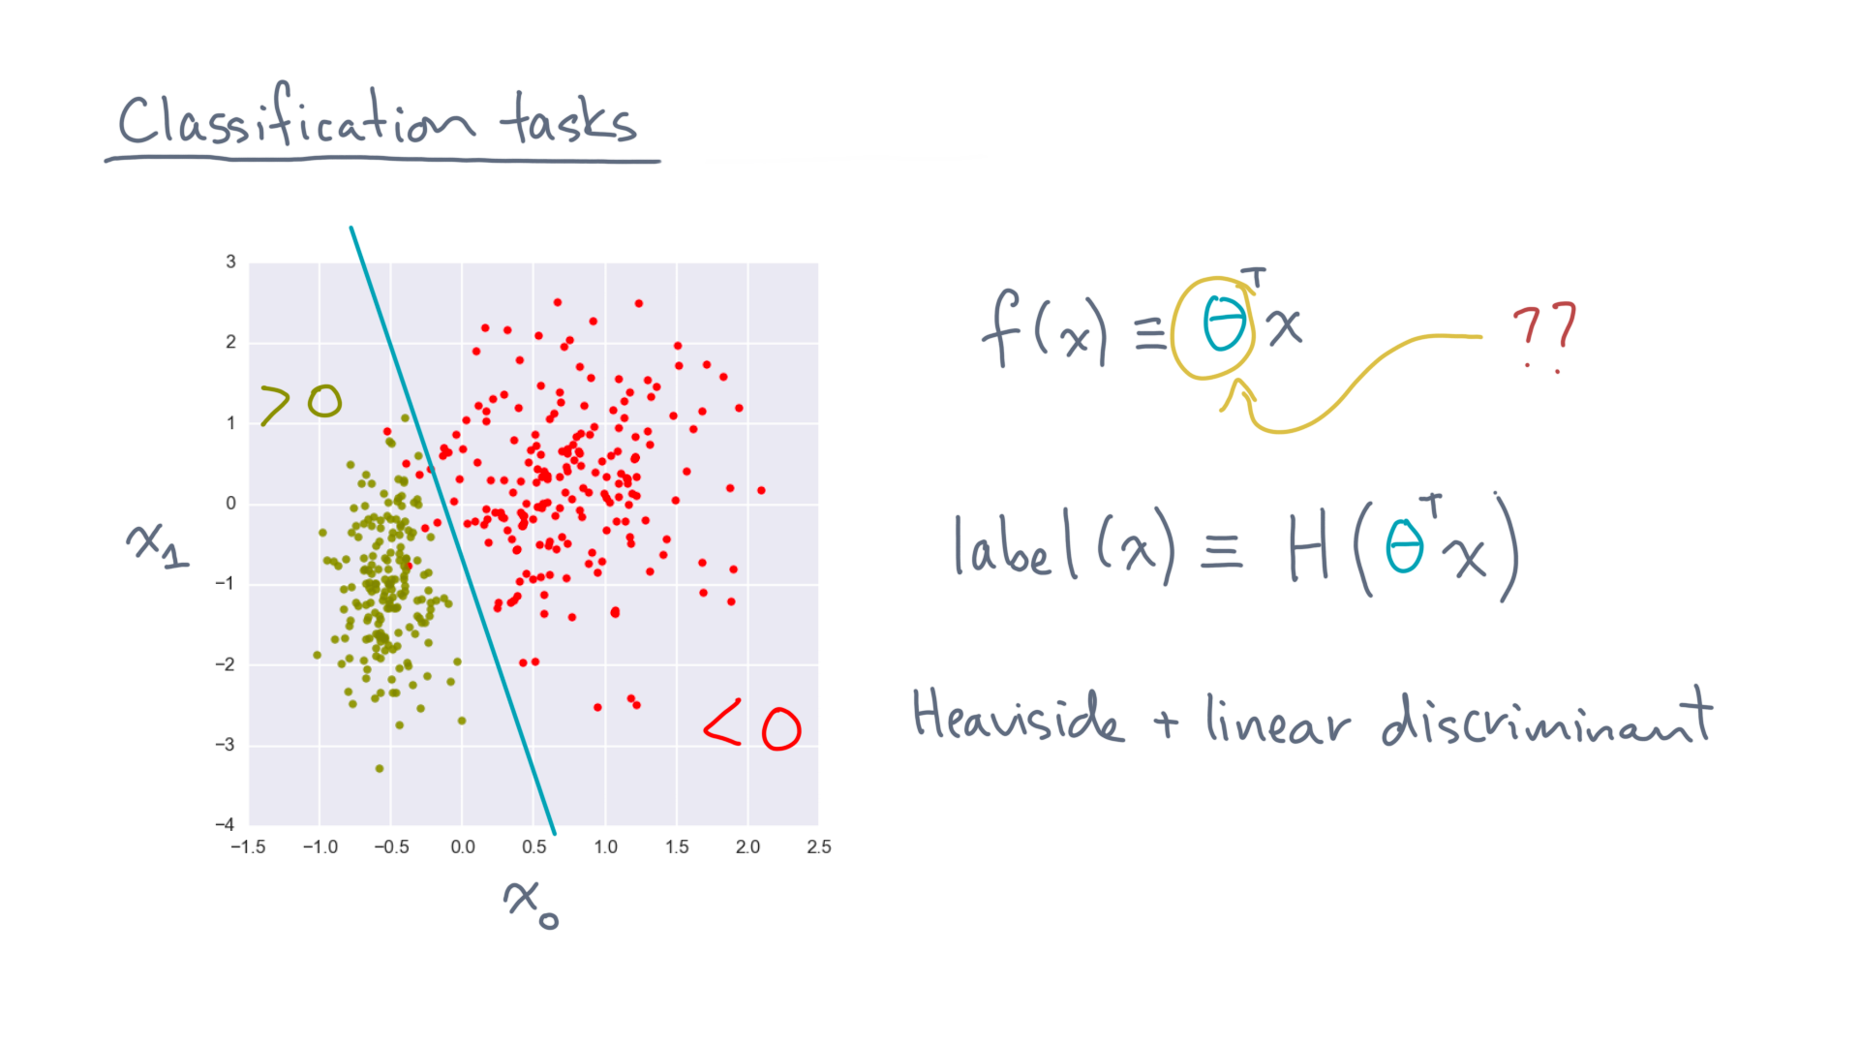
Notes:
How do we pick theta?

Slide 41
Notes:
Before we solve the problem of how to pick theta, here’s what I’d like you to do.
Take a look at the notebook we made to accompany this lesson.
It will have you code up a few of the things we just discussed, and run some experiments.

Slide 42
Notes:
Those exercises will give you some important intuition, not just about how to implement these ideas, but also about how we might try to pick theta systematically.
So have fun, and we’ll see you when you get back!

